Slide 1
STAT50
2.2 Continued 2/08/2021

Slide 2










































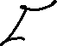





Slide 3











Slide 4







































Slide 5


















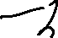








Slide 6















Slide 7





















Slide 8






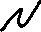







Slide 9









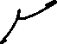




















Slide 10







































Slide 11







































Slide 12







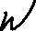




















Slide 13










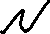









Slide 14



































Slide 15













Slide 16
























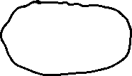


Slide 17





















